Slide 1

Week 31/03/2023

Slide 2
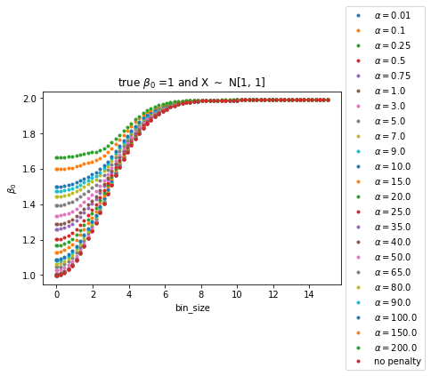
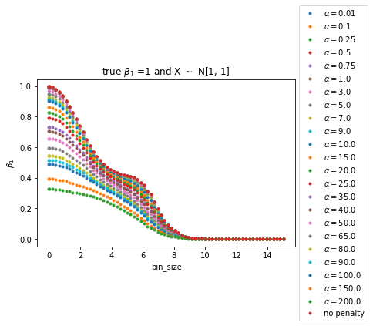
LINear regression
PLAYING WITH RIDGE
FOR y = 1 + 1*X + e

Slide 3
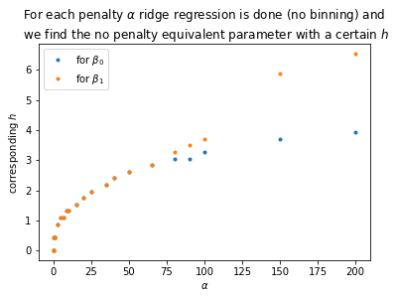
Connection y = 1 + 1*X + e

Slide 4
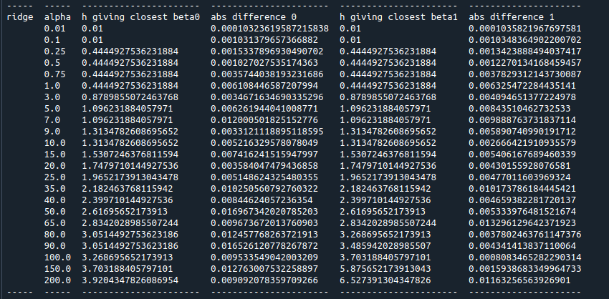
CONNECTION TABLE

Slide 5
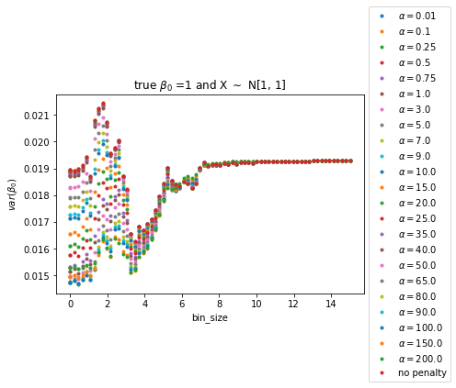
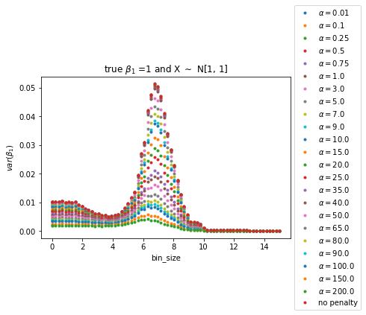
Variance of estimates

Slide 6
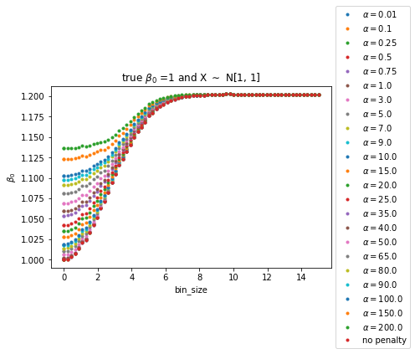
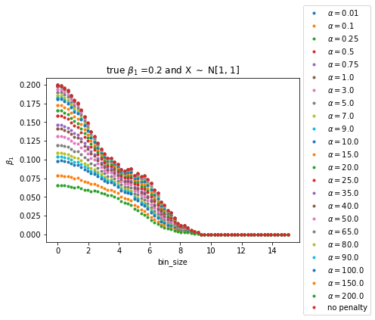
LINear regression
PLAYING WITH RIDGE
FOR y = 1 + 0.2*X + e

Slide 7
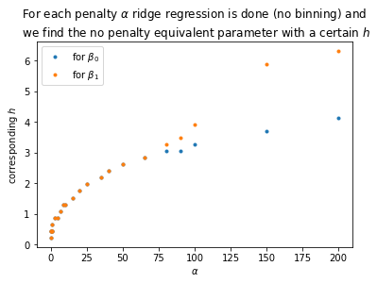
Connection y = 1 + 0.2*X + E

Slide 8
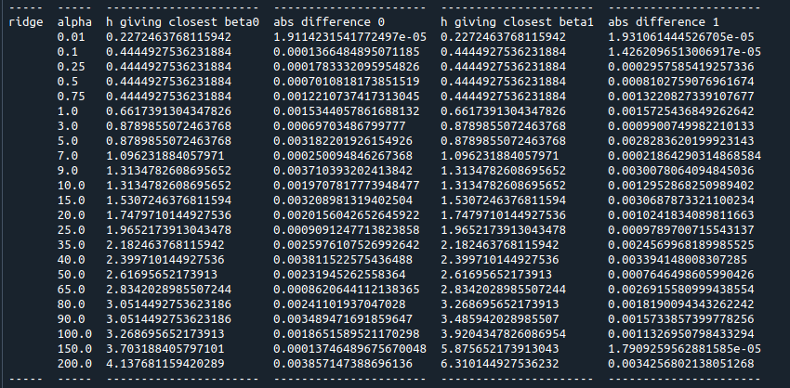
CONNECTION TABLE

Slide 9
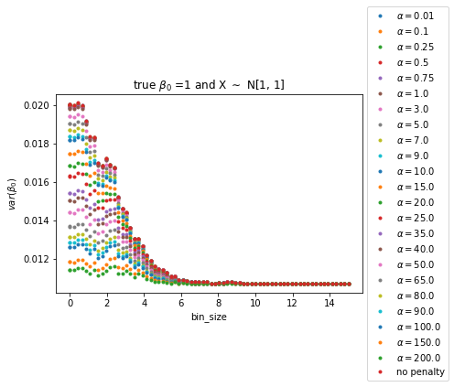
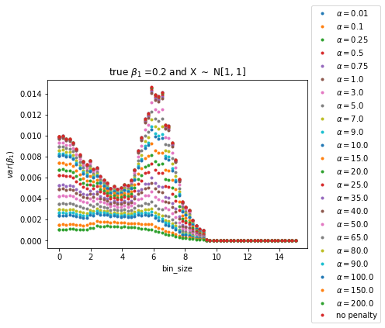
Variance of estimates

Slide 10
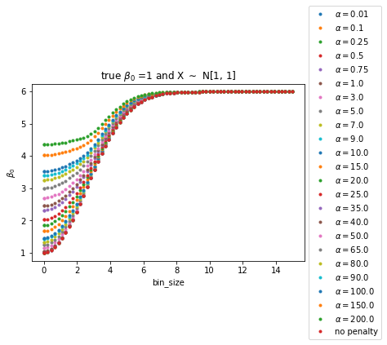

LINear regression
PLAYING WITH RIDGE
FOR y = 1 + 5*X + e

Slide 11
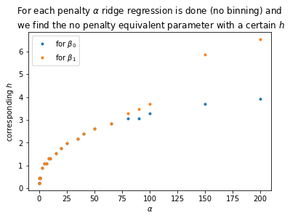
Connection y = 1 + 5*X + e

Slide 12
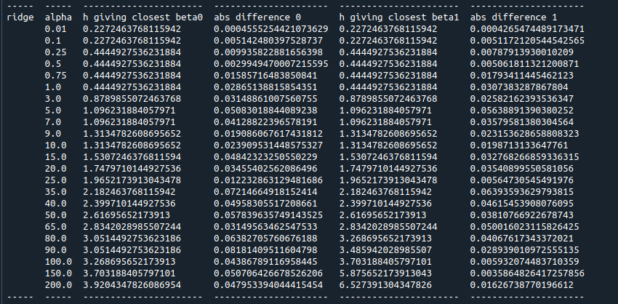
CONNECTION TABLE

Slide 13
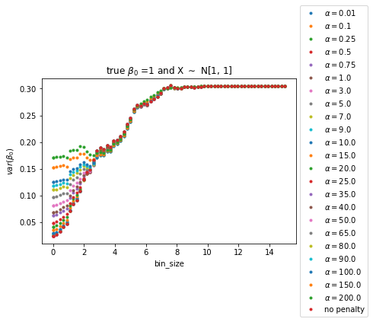
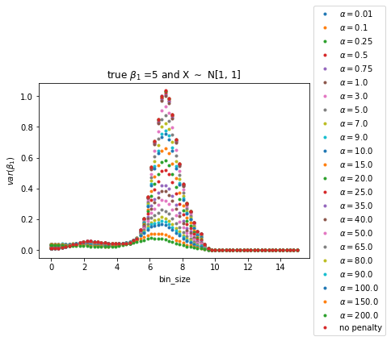
Variance of estimates

Slide 14

Y = 0.2 + X + E

Slide 15
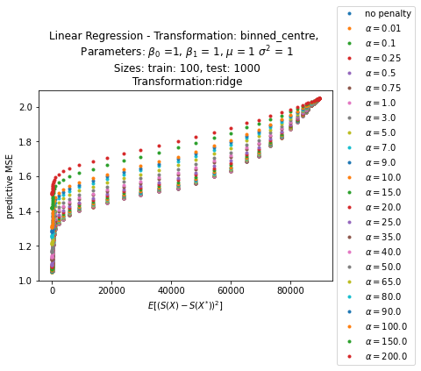
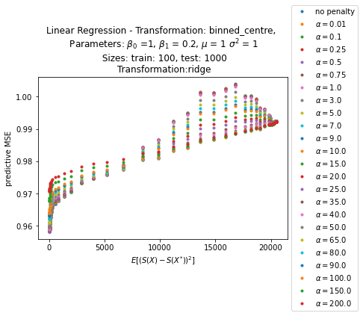

Slide 16
